Slide 1
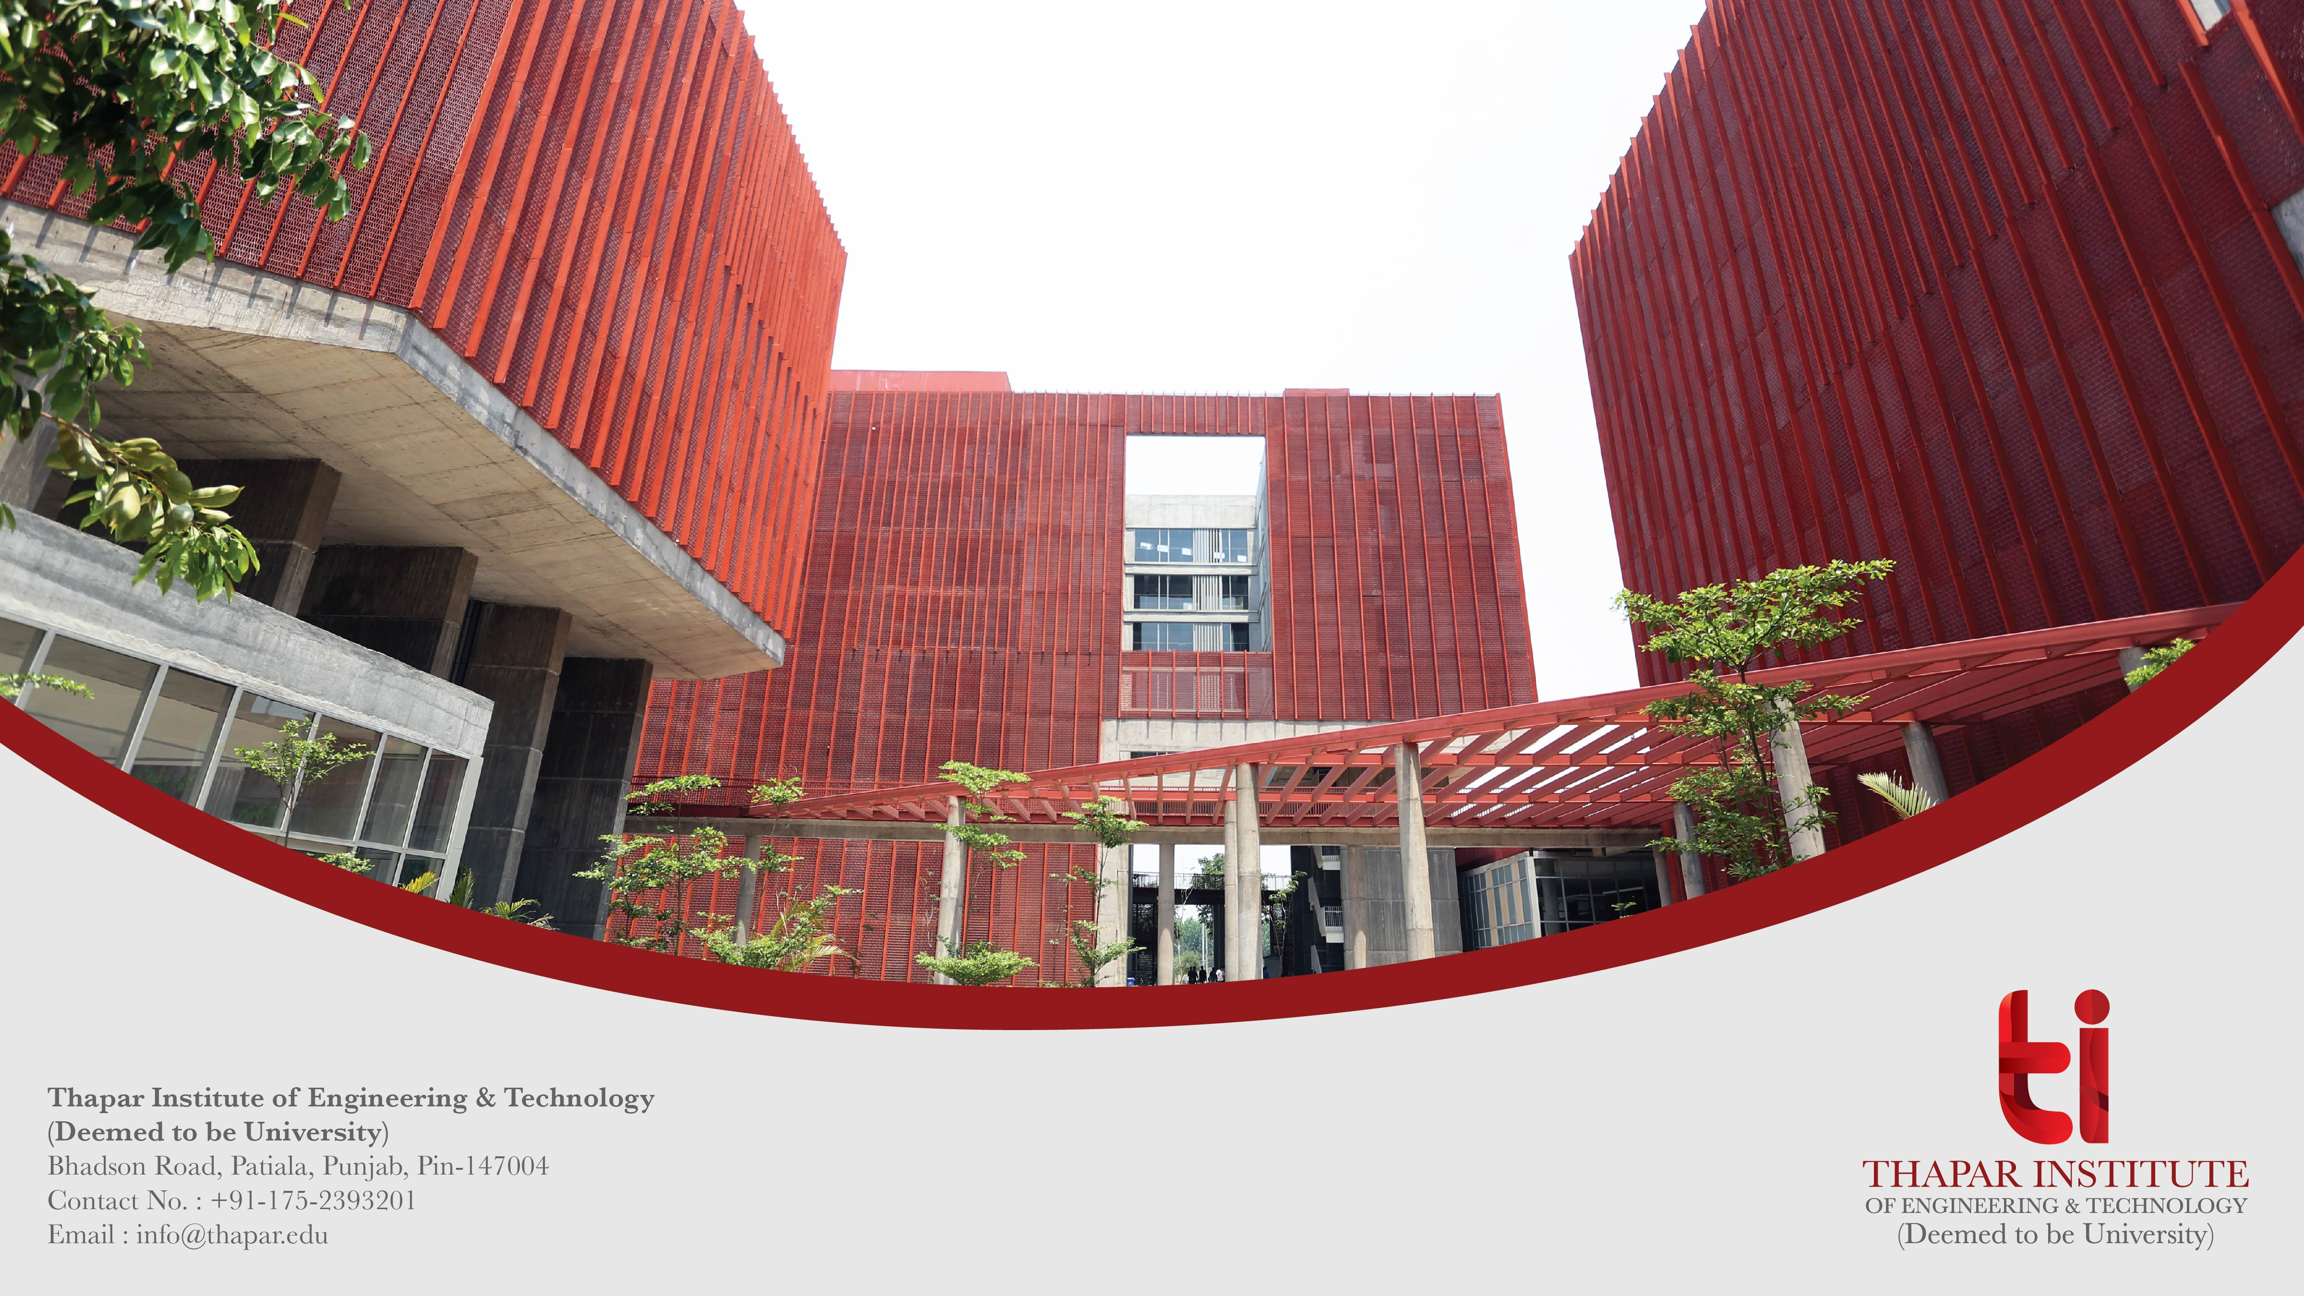
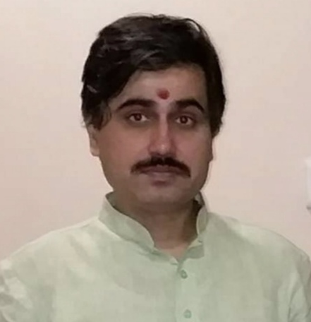
Analog Electronic Circuits (UEC301)
By
Dr.Mayank Kumar Rai
Associate Professor,
ECED,TIET,Patiala

Slide 2

Analog Electronic circuits(301): Course Introduction and Materials
Introduction: This course actually introduces basic methods for the analysis and design of transistor amplifier circuits, oscillators and wave shaping circuits.
Who is this course:
This course is design for ECE and ENC students that are comfortable with the fundamental concepts of electrical and electronic components viz. resistors, capacitors, transistors etc.
You will need to known Ohm’s law and the relationship between power, voltage and current.
I hope that you are comfortable with the basic theory of Bipolar transistor and MOSFET.

Slide 3
What Will You Learn ?
Here is the syllabus of this course : When you complete this course, you will have been exposed to nearly all of the most common analog electronic circuits and design problems.
Unit I (Transistor Biasing and Thermal Stabilization): The Operating Point, Biasing Stability, Self-Biasing or Emitter Bias, Stabilization against Variations in I_{co}, V_{BE}, and β, General Remarks on Collector-Current Stability, Bias Compensation, Thermal Runaway, Thermal Stability, The FET Small-Signal Model, The metal-oxide-semiconductor FET (MOSFET), The low-frequency common-source and common-drain amplifiers, Biasing FET.
Unit II (Transistor at Low and High Frequencies: Low frequency h-parameter model of BJT, The Hybrid-pi Common-emitter Transistor Model, Hybrid-pi conductance, The Hybrid-pi Capacitances, Variation of Hybrid-pi parameters, The CE short-circuit current gain, The gain-bandwidth product.

Slide 4
Unit III ( Multistage Amplifiers): Classification of amplifiers, Distortion in amplifiers, Frequency response of an amplifier, Step Response of an amplifier, Band pass of cascaded stages, The RC-coupled amplifier, Low-frequency response of an RC-coupled stage, Effect of an emitter Bypass capacitor on low-frequency response.
Unit IV ( Power Amplifiers): Class A, B, AB, Push pull & Class C amplifiers, Comparison of their Efficiencies, Types of distortion.
Unit V (Feedback Amplifiers): Classification of Amplifiers, The feedback concept, The transfer gain with feedback, General characteristics of negative-feedback amplifiers, Input resistance, Output resistance, Method of Analysis of a Feedback Amplifier, Voltage-series feedback, Current-series feedback, Current-shunt feedback, Voltage-shunt feedback.

Slide 5
Unit VI (Stability and Oscillators): Sinusoidal Oscillator, The phase-shift oscillator, Resonant-circuit oscillators, A General form of oscillator circuit, The Wien Bridge oscillator, Crystal oscillator, Frequency Stability.
Unit VII (Wave shaping circuits): Multi-vibratotrs (Astable, Mono-stable, Bi-Stable), High pass and low pass filters using R-C Circuits & their response to step input, Pulse input, Square input and Ramp Input, Schmitt Trigger.

Slide 6
Books: Here are a list of reference books that you may either already have, can purchase, or
borrow from a friend or download a soft copy.
Jacob Milman & and C.C.Halkias, “Integrated Electronics Analog and Digital Circuit and Systems”Second Edition.
Adel S. Sedra & K. C. Smith, “Micro Electronic Circuits Theory and Application” Fifth Edition.
Robert L. Boylestad & L. Nashelsky, “Electronic Devices and Circuit Theory” Eleventh Edition.

Slide 7
Faculty names:
(1) Dr. Mayank Kumar Rai ( Associate Professor & Course Coordinator)
mail id: mkrai@thapar.edu
(2) Dr. Arun Chatterjee(Assistant Professor)
(3) Dr. Subiman Chatterjee(Assistant Professor)

Slide 8
Thank You

